Slide 1

Chapter-I
INTRODUCTION

Slide 2
Chapter 1 – Introduction
The art of war teaches us to rely not on the likelihood of the enemy's not coming, but on our own readiness to receive him; not on the chance of his not attacking, but rather on the fact that we have made our position unassailable.
—The Art of War, Sun Tzu
Notes:
This quote from the start of Ch0 sets the scene for why we want to study these issues.

Slide 3
Background
Information Security requirements have changed in recent times.
Traditionally provided by physical and administrative mechanisms.
Computer use requires automated tools to protect files and other stored information.
Use of networks and communications links requires measures to protect data during transmission.
Notes:
The requirements of information security within an organization have undergone two major changes in the last several decades. Before the widespread use of data processing equipment,the security of information felt to be valuable to an organization was provided primarily by physical (eg. rugged filing cabinets with locks) and administrative mechanisms (eg. Personnel screening procedures during hiring process).
Growing computer use implies a need for automated tools for protecting files and other information stored on it. This is especially the case for a shared system, such as a time-sharing system, and even more so for systems that can be accessed over a public telephone network, data network, or the Internet.
The second major change that affected security is the introduction of distributed systems and the use of networks and communications facilities for carrying data between terminal user and computer and between computer and computer. Network security measures are needed to protect data during their transmission.

Slide 4
Definitions
Computer Security - generic name for the collection of tools designed to protect data and to thwart hackers.
Network Security - measures to protect data during their transmission.
Internet Security - measures to protect data during their transmission over a collection of interconnected networks.
Notes:
Here are some key definitions, note boundaries between them are blurred.

Slide 5

Aim of Course
our focus is on Internet Security
which consists of measures to deter, prevent, detect, and correct security violations that involve the transmission & storage of information
Notes:
Detail the focus of this book/course, which is on Internet Security - being measures to deter, prevent, detect, and correct security violations that involve the transmission & storage of information.

Slide 6
Security?
What does it refer to?
Three Fundamentals –
Confidentiality (Data confidentiality, Privacy)
  Authorized users get entry
  Inspection of information, printing of information and knowledge of resource existence
Availability
  Legitimate user be able to access resources and service should be provided at anytime
Integrity (Data integrity & System integrity)
  Changed in adequate way
  Modification done by authorized people
Notes:
Detail the focus of this book/course, which is on Internet Security - being measures to deter, prevent, detect, and correct security violations that involve the transmission & storage of information.

Slide 7
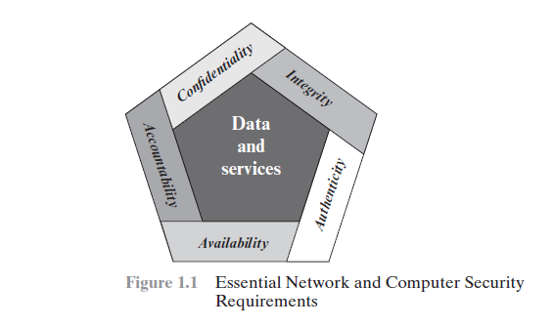
Contd..

Slide 8
Authenticity:
The property of being genuine and being able to be verified and trusted; confidence in the validity of a transmission, a message, or message originator. This means verifying that users are who they say they are and that each input arriving at the system came from a trusted source.
Accountability: The security goal that generates the requirement for actions of an entity to be traced uniquely to that entity. This supports nonrepudiation, deterrence, fault isolation, intrusion detection and prevention, and afteraction recovery and legal action.

Slide 9
Security?
Basic information security concepts:
  Confidentiality
  Integrity
  Availability
  Authentication - the process or action of verifying the identity of a user or process.
  Authorization -Authorization is a security mechanism to determine access levels or user/client privileges related to system resources including files, services, computer programs, data and application features.
  • Non-repudiation- assurance that the sender of information is provided with proof of delivery, and the recipient is provided with proof of the sender's identity, so neither can later deny having process the information.
Notes:
Detail the focus of this book/course, which is on Internet Security - being measures to deter, prevent, detect, and correct security violations that involve the transmission & storage of information.

Slide 10
CHALLENGES
The mechanisms used to meet security requirements can be quite complex, and understanding them may involve rather subtle reasoning.
In developing a particular security mechanism or algorithm, one must always consider potential attacks on those security features.
The procedures used to provide particular services are often counterintuitive.
Having designed various security mechanisms, it is necessary to decide where to use them.
Ex: Physical Place,Logical Sense.

Slide 11
Contd..
Security mechanisms typically involve more than a particular algorithm or protocol.
Computer and network security is essentially a battle of wits between a perpetrator who tries to find holes and the designer or administrator who tries to close them.
There is a natural tendency on the part of users and system managers to perceive little benefit from security investment until a security failure occurs.

Slide 12
Contd…
Security requires regular, even constant, monitoring, and this is difficult in today’s short-term, overloaded environment.
Security is still too often an afterthought to be incorporated into a system after the design is complete.
Many users and even security administrators view strong security as an impediment to efficient and user-friendly operation of an information system or use of information.

Slide 13
OSI Security Architecture
ITU-T X.800 “Security Architecture for OSI”
defines a systematic way of defining and providing security requirements
for us it provides a useful, if abstract, overview of concepts we will study
Notes:
To assess effectively the security needs of an organization and to evaluate and choose various security products and policies, the manager responsible for security needs some systematic way of defining the requirements for security and characterizing the approaches to satisfying those requirements. This is difficult enough in a centralized data processing environment; with the use of local and wide area networks,the problems are compounded. ITU-T Recommendation X.800, Security Architecture for OSI, defines such a systematic approach. The OSI security architecture is useful to managers as a way of organizing the task of providing security.

Slide 14
Aspects of Security
consider 3 aspects of information security:
  security attack
  security mechanism
  security service
Notes:
The OSI security architecture focuses on security attacks,mechanisms,and services. These can be defined briefly as follows:
• Security attack: Any action that compromises the security of information owned by an organization.
• Security mechanism: A process (or a device incorporating such a process) that is designed to detect, prevent,or recover from a security attack.
• Security service: A processing or communication service that enhances the security of the data processing systems and the information transfers of an organization.The services are intended to counter security attacks, and they make use of one or more security mechanisms to provide the service.

Slide 15
Security Attack
any action that compromises the security of information owned by an organization
information security is about how to prevent attacks, or failing that, to detect attacks on information-based systems
often threat & attack used to mean same thing
Threat-A potential for violation of security, which exists when there is a circumstance, capability, action, or event that could breach security and cause harm. That is, a threat is a possible danger that might exploit a vulnerability.
Notes:
Expand on definition and use of “security attack”, as detailed above.
See Stallings Table 1.1 for definitions of threat and attack.

Slide 16
Security Attack
Attack-An assault on system security that derives from an intelligent threat; that is, an intelligent act that is a deliberate attempt (especially in the sense of a method or technique) to evade security services and violate the security policy of a system.
Two generic types of attacks
  passive
  active
Notes:
Expand on definition and use of “security attack”, as detailed above.
See Stallings Table 1.1 for definitions of threat and attack.

Slide 17
Security Attack
Passive attacks are in the nature of eavesdropping on, or monitoring of, transmissions.
The goal of the opponent is to obtain information that is being transmitted.
Two types of passive attacks are
  release of message contents and
  traffic analysis.
Notes:
Expand on definition and use of “security attack”, as detailed above.
See Stallings Table 1.1 for definitions of threat and attack.

Slide 18
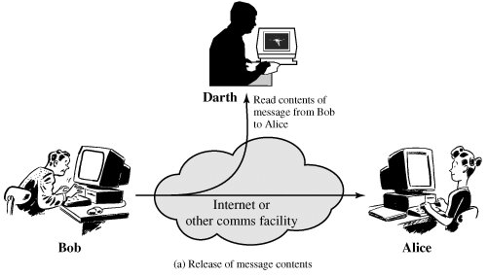
Passive Attacks – Release of message contents
Notes:
Have “passive attacks” which attempt to learn or make use of information from the system but does not affect system resources.
By eavesdropping on, or monitoring of, transmissions to:
+ obtain message contents (as shown above in Stallings Figure 1.3a), or
+ monitor traffic flows
Are difficult to detect because they do not involve any alteration of the data.
A telephone conversation, an electronic mail message, and a transferred file may contain sensitive or confidential information. We would like to prevent an opponent from learning the contents of these transmissions.

Slide 19
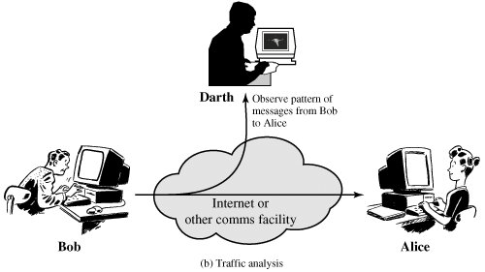
Passive Attacks – Traffic analysis
Notes:
Suppose that we had a way of masking the contents of messages or other information traffic so that opponents, even if they captured the message, could not extract the information from the message. The common technique for masking contents is encryption. If we had encryption protection in place, an opponent might still be able to observe the pattern of these messages. The opponent could determine the location and identity of communicating hosts and could observe the frequency and length of messages being exchanged. This information might be useful in guessing the nature of the communication that was taking place.

Slide 20
Active Attacks
“active attacks” attempt to alter system resources or affect their operation.
By modification of data stream to:
  masquerade of one entity as some other
  replay previous messages
  modify messages in transit
  denial of service
Notes:
Also have “active attacks” which attempt to alter system resources or affect their operation.
By modification of data stream to:
+ masquerade of one entity as some other
+ replay previous messages (as shown above in Stallings Figure 1.4b)
+ modify messages in transit
+ denial of service
Active attacks present the opposite characteristics of passive attacks. Whereas passive attacks are difficult to detect, measures are available to prevent their success. On the other hand, it is quite difficult to prevent active attacks absolutely, because of the wide variety of potential physical,software,and network vulnerabilities. Instead, the goal is to detect active attacks and to recover from any disruption or delays caused by them.

Slide 21
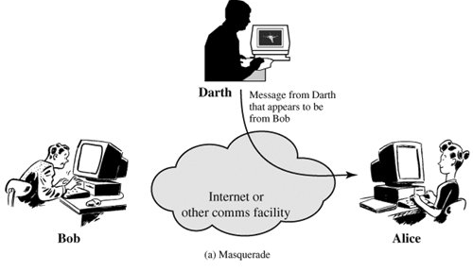
Active Attacks
Notes:
Active attacks present the opposite characteristics of passive attacks. Whereas passive attacks are difficult to detect, measures are available to prevent their success. On the other hand, it is quite difficult to prevent active attacks absolutely, because of the wide variety of potential physical,software,and network vulnerabilities. Instead, the goal is to detect active attacks and to recover from any disruption or delays caused by them.

Slide 22
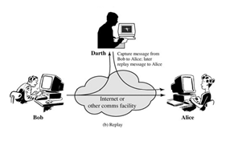
Active Attacks
Notes:
Active attacks present the opposite characteristics of passive attacks. Whereas passive attacks are difficult to detect, measures are available to prevent their success. On the other hand, it is quite difficult to prevent active attacks absolutely, because of the wide variety of potential physical,software,and network vulnerabilities. Instead, the goal is to detect active attacks and to recover from any disruption or delays caused by them.

Slide 23
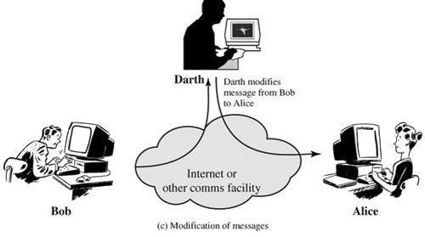
Active Attacks
Notes:
Active attacks present the opposite characteristics of passive attacks. Whereas passive attacks are difficult to detect, measures are available to prevent their success. On the other hand, it is quite difficult to prevent active attacks absolutely, because of the wide variety of potential physical,software,and network vulnerabilities. Instead, the goal is to detect active attacks and to recover from any disruption or delays caused by them.

Slide 24
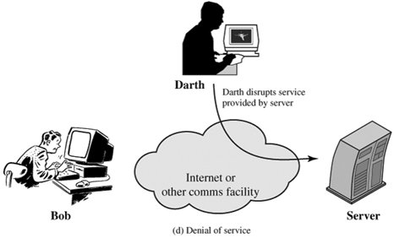
Active Attacks
Notes:
Active attacks present the opposite characteristics of passive attacks. Whereas passive attacks are difficult to detect, measures are available to prevent their success. On the other hand, it is quite difficult to prevent active attacks absolutely, because of the wide variety of potential physical,software,and network vulnerabilities. Instead, the goal is to detect active attacks and to recover from any disruption or delays caused by them.

Slide 25
Security Service
  enhance security of data processing systems and information transfers of an organization
  intended to counter security attacks
  using one or more security mechanisms
X.800:
  “a service provided by a protocol layer of communicating open systems, which ensures adequate security of the systems or of data transfers”
RFC 2828:
  “a processing or communication service provided by a system to give a specific kind of protection to system resources”
Notes:
Consider the role of a security service, and what may be required.
Note both similarities and differences with traditional paper documents, which for example:
have signatures & dates;
need protection from disclosure, tampering, or destruction;
may be notarized or witnessed;
may be recorded or licensed

Slide 26
Security Services (X.800)
Authentication - assurance that the communicating entity is the one claimed
Access Control - prevention of the unauthorized use of a resource
Data Confidentiality –protection of data from unauthorized disclosure
Data Integrity - assurance that data received is as sent by an authorized entity
Non-Repudiation - protection against denial by one of the parties in a communication
Notes:
This list includes the various "classic" security services which are traditionally discussed.
Note there is a degree of ambiguity as to the meaning of these terms, and overlap in their use.
See Stallings Table 1.2 for details of the 5 Security Service categories and the 14 specific services given in X.800.

Slide 27
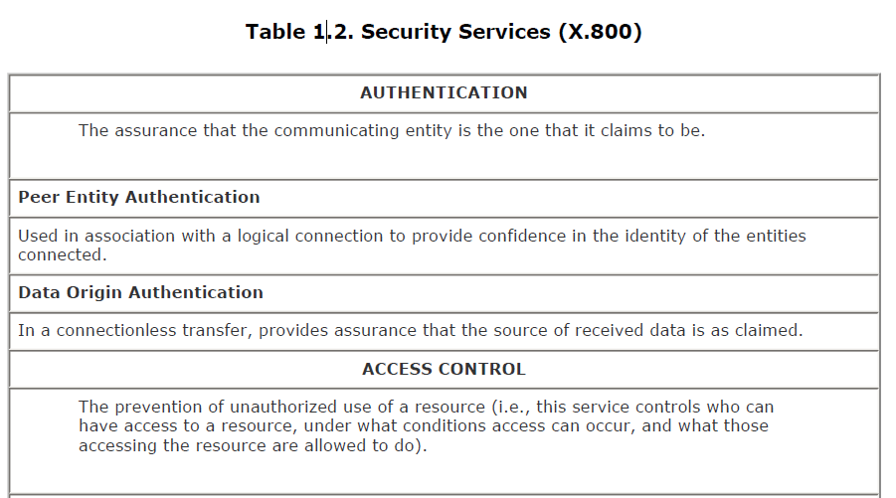
Security Services
Notes:
Also have a couple of definition of “security services” from relevant standards. X.800 defines a security service as a service provided by a protocol layer of communicating open systems, which ensures adequate security of the systems or of data transfers. Perhaps a clearer definition is found in RFC 2828, which provides the following definition: a processing or communication service that is provided by a system to give a specific kind of protection to system resources; security services implement security policies and are implemented by security mechanisms.

Slide 28
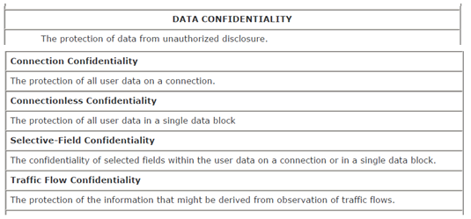
Security Services
Notes:
Also have a couple of definition of “security services” from relevant standards. X.800 defines a security service as a service provided by a protocol layer of communicating open systems, which ensures adequate security of the systems or of data transfers. Perhaps a clearer definition is found in RFC 2828, which provides the following definition: a processing or communication service that is provided by a system to give a specific kind of protection to system resources; security services implement security policies and are implemented by security mechanisms.

Slide 29
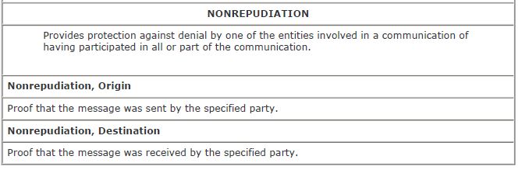
Security Services
Notes:
Also have a couple of definition of “security services” from relevant standards. X.800 defines a security service as a service provided by a protocol layer of communicating open systems, which ensures adequate security of the systems or of data transfers. Perhaps a clearer definition is found in RFC 2828, which provides the following definition: a processing or communication service that is provided by a system to give a specific kind of protection to system resources; security services implement security policies and are implemented by security mechanisms.

Slide 30
Security Mechanism
feature designed to detect, prevent, or recover from a security attack
no single mechanism that will support all services required
however one particular element underlies many of the security mechanisms in use:
  cryptographic techniques
hence our focus on this topic
Notes:
Now introduce “Security Mechanism” which are the specific means of implementing one or more security services.
Note these mechanisms span a wide range of technical components, but one aspect seen in many is the use of cryptographic techniques.

Slide 31
Security Mechanisms (X.800)
specific security mechanisms:
  encipherment, digital signatures, access controls, data integrity, authentication exchange, traffic padding, routing control, notarization
pervasive security mechanisms:
  trusted functionality, security labels, event detection, security audit trails, security recovery
Notes:
Some examples of mechanisms from X.800. Note that the “specific security mechanisms” are protocol layer specific, whilst the “pervasive security mechanisms” are not. We will meet some of these mechanisms in much greater detail later.
See Stallings Table 1.3 for details of these mechanisms in X.800, and Table 1.4 for the relationship between services and mechanisms.

Slide 32
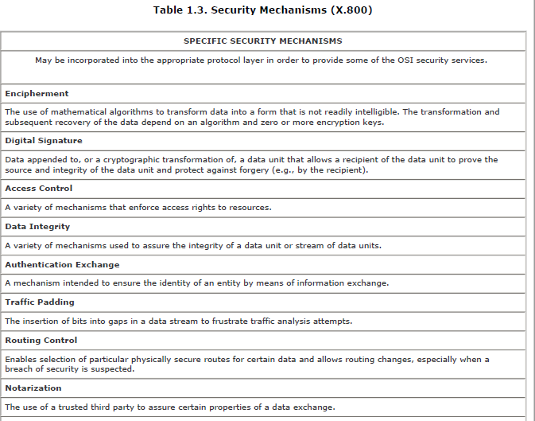
Security Mechanisms (X.800)
Notes:
In considering the place of encryption, its useful to use the following two models from Stallings section 1.6.
The first, illustrated in Figure 1.5, models information flowing over an insecure communications channel, in the presence of possible opponents. Hence an appropriate security transform (encryption algorithm) can be used, with suitable keys, possibly negotiated using the presence of a trusted third party.

Slide 33
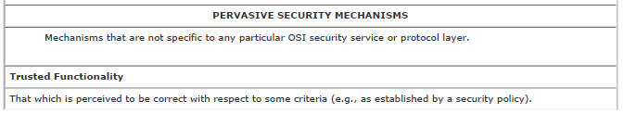
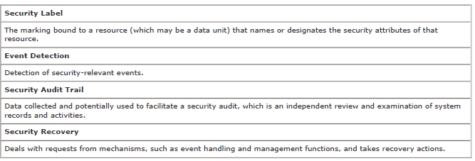
Security Mechanisms (X.800)
Notes:
In considering the place of encryption, its useful to use the following two models from Stallings section 1.6.
The first, illustrated in Figure 1.5, models information flowing over an insecure communications channel, in the presence of possible opponents. Hence an appropriate security transform (encryption algorithm) can be used, with suitable keys, possibly negotiated using the presence of a trusted third party.

Slide 34
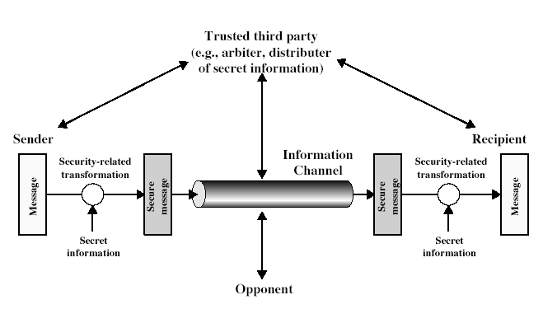
Model for Network Security
Notes:
In considering the place of encryption, its useful to use the following two models from Stallings section 1.6.
The first, illustrated in Figure 1.5, models information flowing over an insecure communications channel, in the presence of possible opponents. Hence an appropriate security transform (encryption algorithm) can be used, with suitable keys, possibly negotiated using the presence of a trusted third party.

Slide 35
Model for Network Security
using this model requires us to:
  design a suitable algorithm for the security transformation
  generate the secret information (keys) used by the algorithm
  develop methods to distribute and share the secret information
  specify a protocol enabling the principals to use the transformation and secret information for a security service
Notes:
This general model shows that there are four basic tasks in designing a particular security service, as listed.

Slide 36
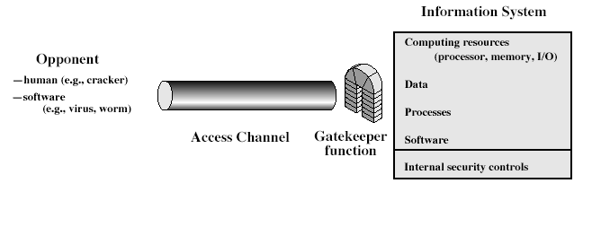
Model for Network Access Security
Notes:
The second, illustrated in Figure 1.6, model is concerned with controlled access to information or resources on a computer system, in the presence of possible opponents. Here appropriate controls are needed on the access and within the system, to provide suitable security. Some cryptographic techniques are useful here also.

Slide 37
Model for Network Access Security
using this model requires us to:
  select appropriate gatekeeper functions to identify users
  implement security controls to ensure only authorised users access designated information or resources
trusted computer systems may be useful to help implement this model
Notes:
Detail here the tasks needed to use this model.
Note that trusted computer systems (discussed in Ch 20 can be useful here).

Slide 38
Summary
have considered:
  definitions for:
    computer, network, internet security
X.800 standard
security attacks, services, mechanisms
models for network (access) security
Notes:
Chapter 1 summary.

